Slide 1

Unlocking UPSC Success: Introducing the AI Personal Study Coach
Welcome to a new era of UPSC preparation. Our AI-powered study coach is designed to transform learning with personalised support, efficient study management, and holistic guidance for aspirants.

Slide 2

UPSC Preparation
UPSC Preparation is one of the toughest academic journeys in India.
Vast syllabus and multiple subjects
Demands consistency, discipline, and smart strategy
Current resources lack adaptiveness, leading to stress and inefficiency
Requires structured approach and unwavering commitment
One-size-fits-all approaches fail to address individual needs

Slide 3

UPSC preparation goes beyond knowledge
Personalised Learning
Efficiency
For different paces and styles
In managing time and resources
Holistic Development
Covering academics, motivation, and stress management

Slide 4

Challenges & Opportunities
Challenges
Opportunities
Overwhelming syllabus
Adaptive AI-powered mentorship
Too much content to cover effectively
Personalized guidance at scale
No personalised guidance
Smart time and resource management
Generic approaches that don't address individual needs
Optimized study schedules and material recommendations
Ineffective self-assessment
Continuous motivation and guidance
Difficulty identifying and addressing weak areas
Support system that adapts to emotional and academic needs
High stress levels
Mental pressure affecting performance and wellbeing

Slide 5








Preliminary Solution Concept
AI Personal Study Coach
A mentor for strategy & motivation
A structured content provider
Organized learning materials tailored to individual needs
Guidance on approach and emotional support
A dashboard for tracking growth
A personalised guide for weaknesses
Visual progress monitoring and insights
Targeted improvement recommendations

Slide 6
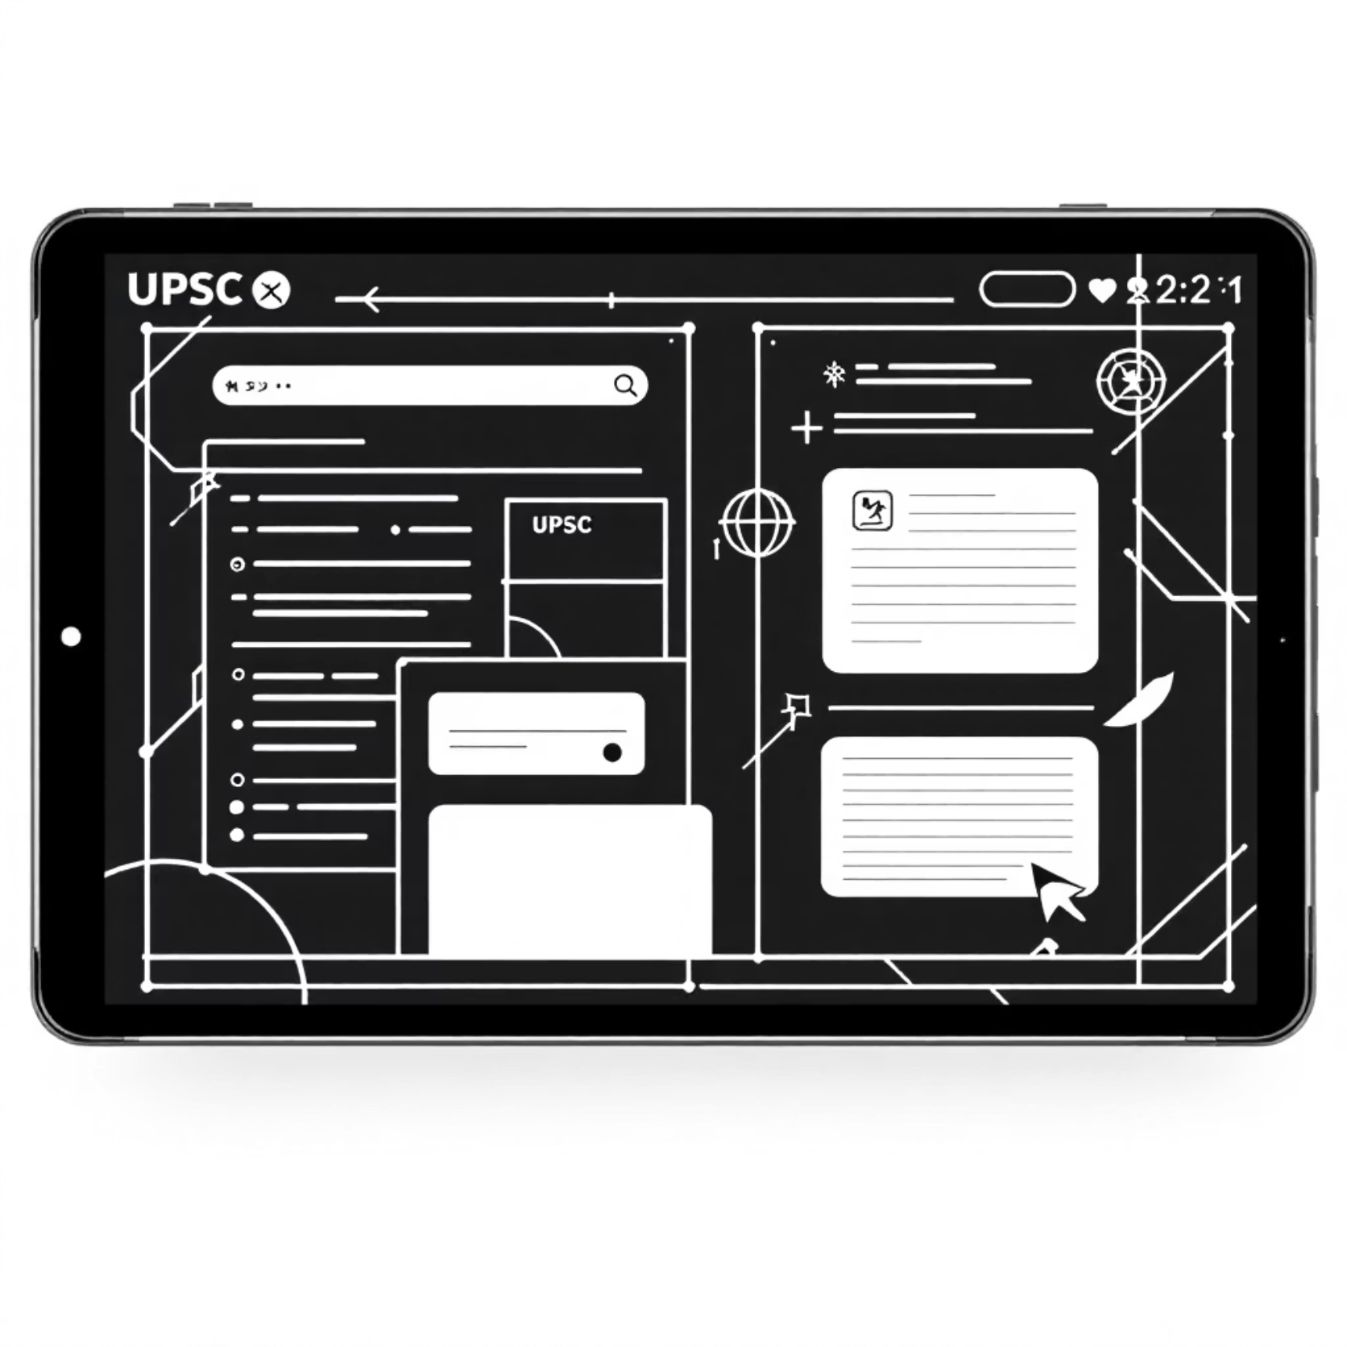

Key Features (Part 1)
1
1
Comprehensive Content Delivery
Dynamic Quizzes & Mock Tests
Structured notes, explanations, and updates
Custom quizzes, full-length tests, instant feedback
Personalized content recommendations
Adaptive difficulty levels
Current affairs integration
Performance analytics

Slide 7
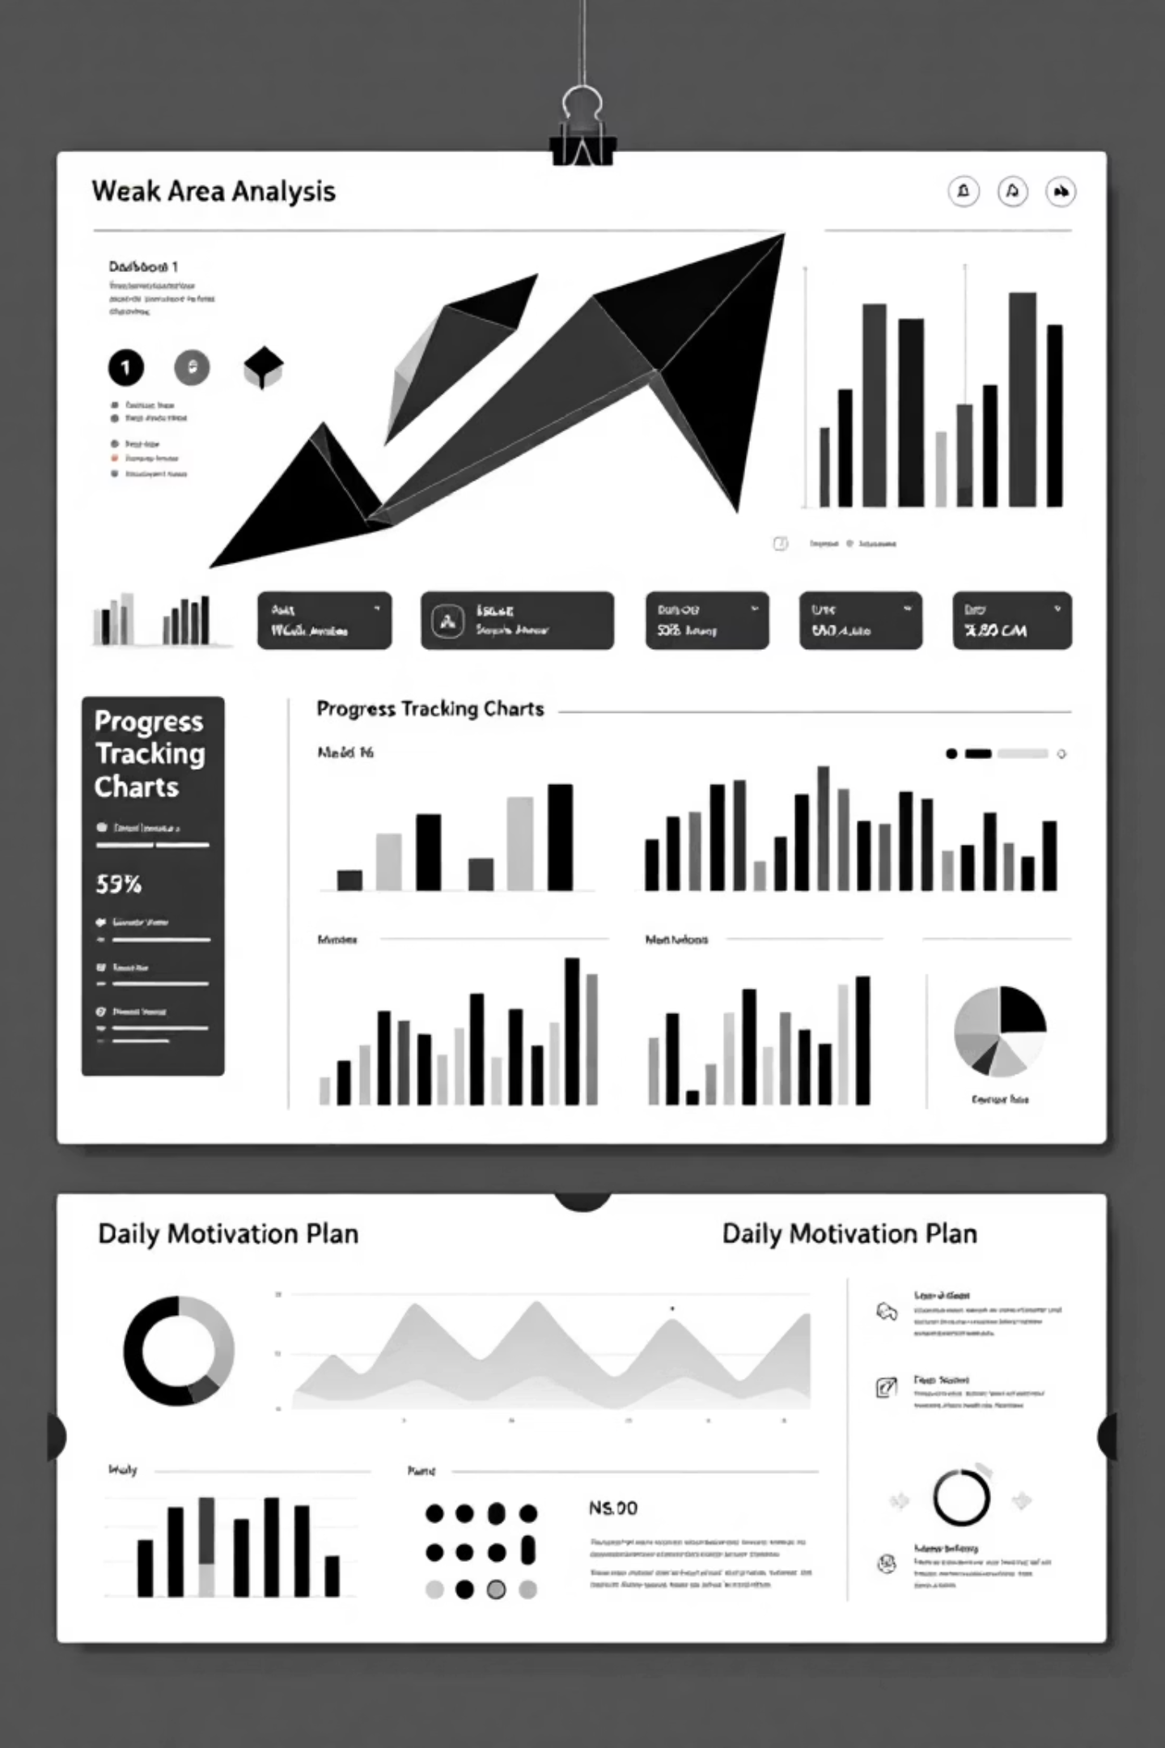
Key Features (Part 2)
Weak Area Analysis
Pinpoints errors, suggests improvements
Pattern recognition in mistakes
Targeted remedial content
Progress Tracking
Visual dashboards, goal monitoring, peer comparison
Performance metrics visualization
Milestone achievements
Motivation & Guidance
Daily plans, success stories, stress management tips
Personalized study schedules
Mental wellness resources

Slide 8





Target Users & Use Cases
Target Users
UPSC aspirants, coaching institutes, self-learners
Use Cases
Revise subjects with AI-generated structured notes
Take customised quizzes and get instant feedback
AI highlights weak areas and suggests targeted practice
Dashboard tracks performance and progress

Slide 9




Tech & Implementation
Technologies
Implementation Approach
Content Integration
1
NLP
Building comprehensive UPSC knowledge base
2
Quiz/Test Engine
Developing adaptive assessment system
Machine Learning
Analytics Dashboard
3
Creating intuitive performance visualization
4
UI/UX Development
Data Analytics
Designing user-friendly interface
Beta Testing & Scaling
5
Refining based on user feedback
Recommender Systems

Slide 10
Evaluation & Impact
Metrics of Success
↑
↓
↑
↑
Improved accuracy in tests
Reduction in weak areas
Consistency of usage & engagement
Student satisfaction and stress reduction
Tracking progress in challenging topics
Measuring knowledge retention and application
Monitoring regular platform interaction
Assessing wellbeing and experience
↑
Higher success rate in prelims & mains
Ultimate measure of platform effectiveness

